Slide 1

HIGH CLOUD AIRLINES
Presented by Group 4 :-
gayatri Balaji aurade
Amol Shivaji mane
Mamatha k n
muheebuddin aqil
Pooja arun kamble
sagar patil
anshu bhardwaj

Slide 2
Table of contents
Introduction To High Cloud Airlines
Objective
Key Performance Indicators
Excel Dashboard
Power BI Dashboard
Tableau Visualization
SQL Queries and Results
Challenges Faced
Conclusion

Slide 3
Introduction to High Cloud Airlines
High cloud Airlines” Likely refers to fictional or hypothetical airline used as a case study or dataset for practicing data analytics skills.
It provides a real world context for data analysis task.
Analysing “ High cloud airlines” data analyst to demonstrate skill in the data exploration , performance metrics analysis, strategic insights, data visualization and report generation.

Slide 4
Objective
To Gain a Comprehensive understanding of “High Cloud Airlines” operations through data
analysis. This will involve investing Load factor, Identifying top carrier names based on passenger
preference, Analyzing popular routes, and exploring other key metrics. The Ultimate goal is to
provide actionable recommendations that can enhance operational efficiency and profitability.

Slide 5
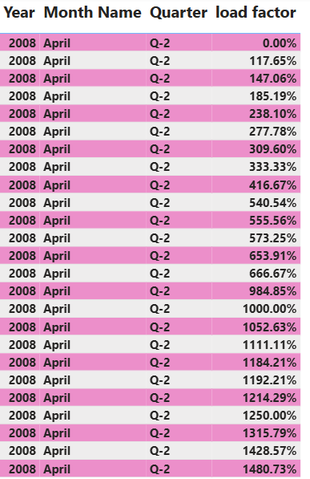
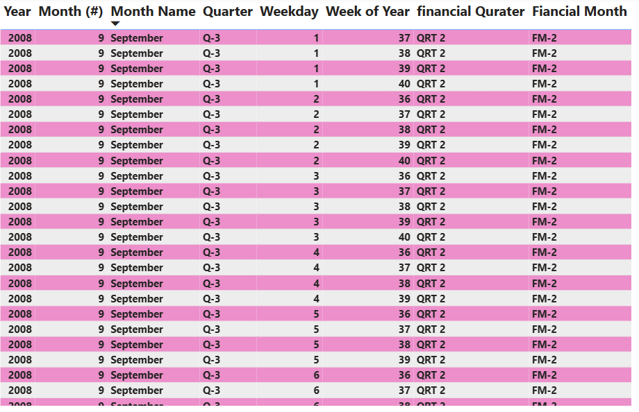
Key Performance Indicators (KPI)

Slide 6
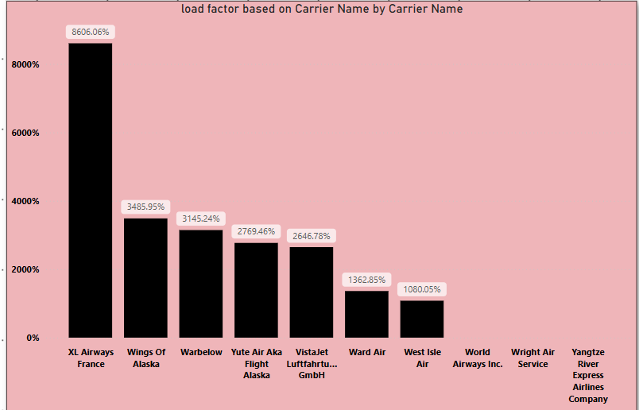
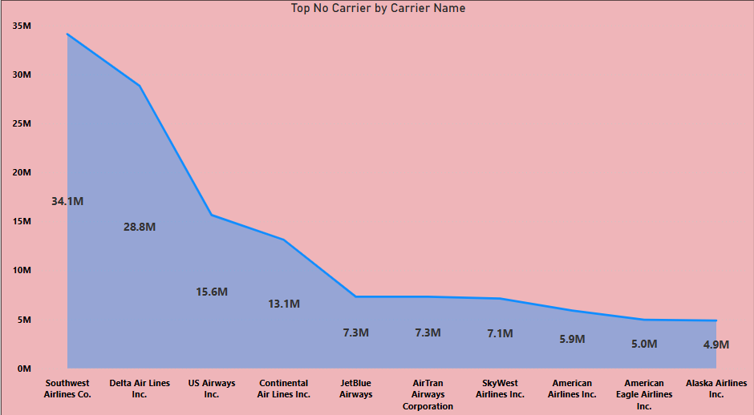
KPI’s

Slide 7
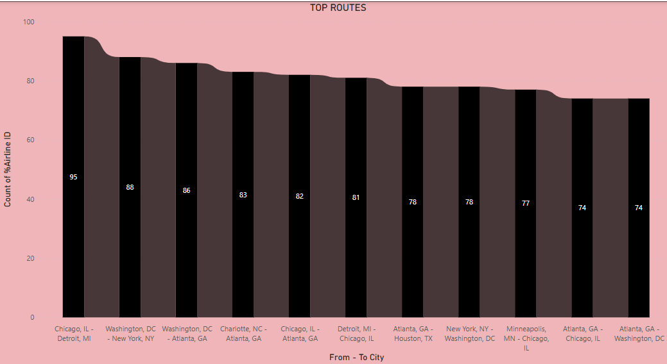
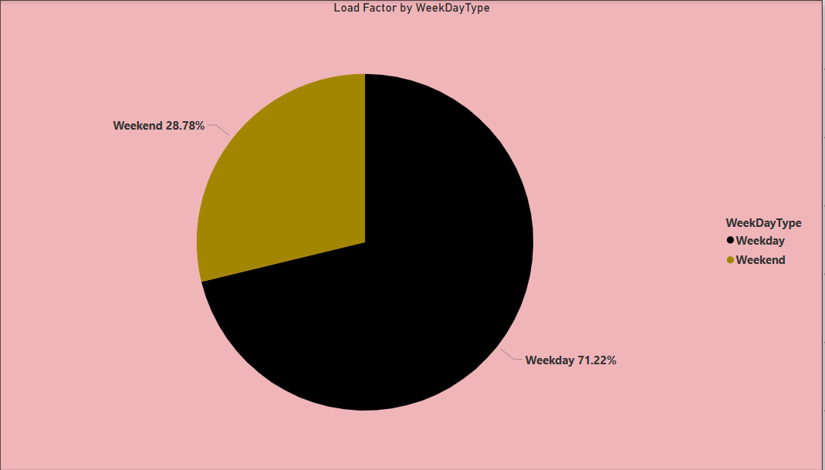
KPI’s

Slide 8

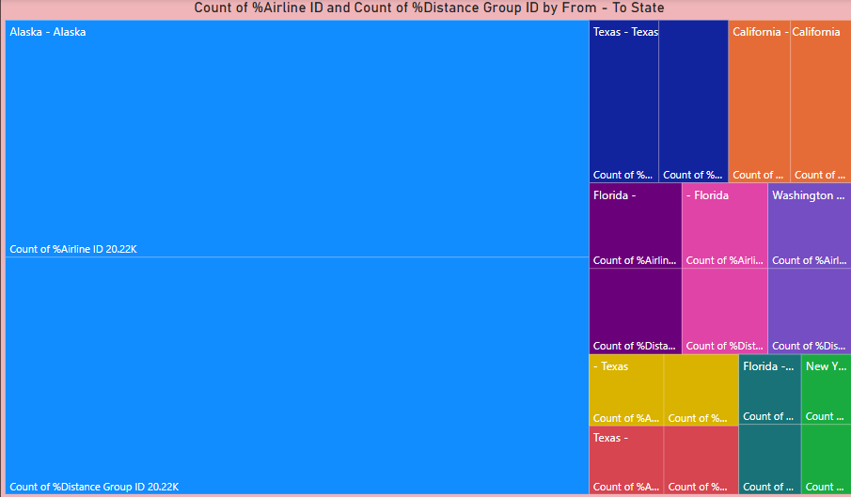
KPI’s

Slide 9
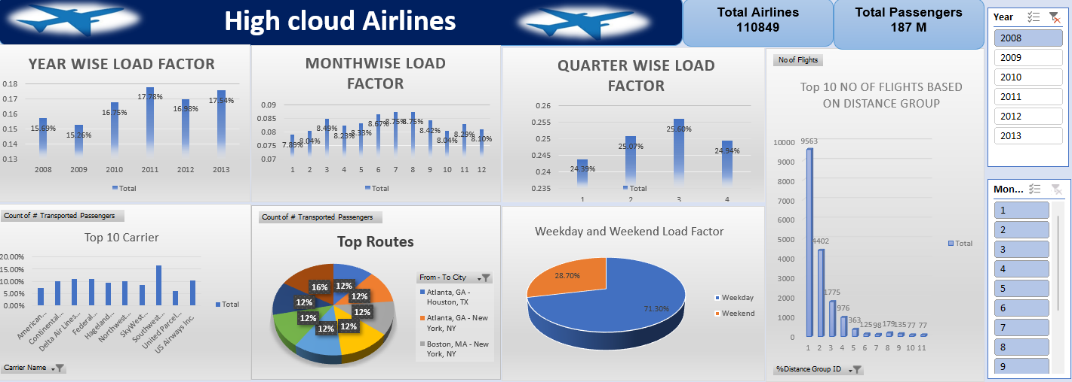
Excel Dashboard

Slide 10
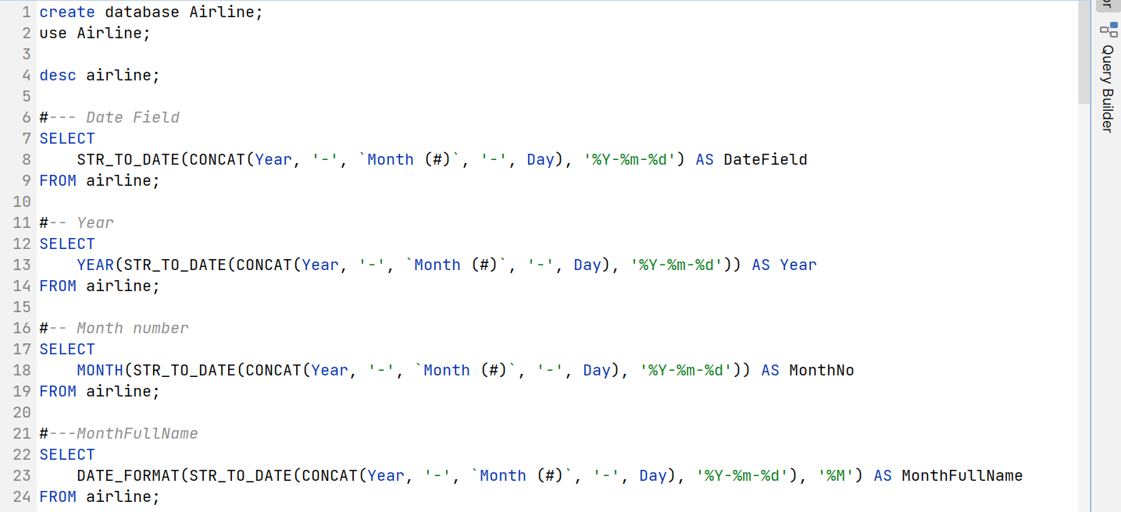
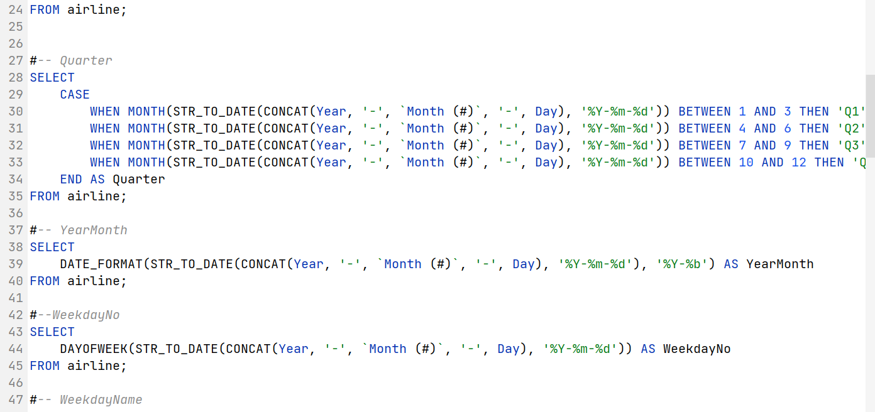
SQL Queries and Results

Slide 11
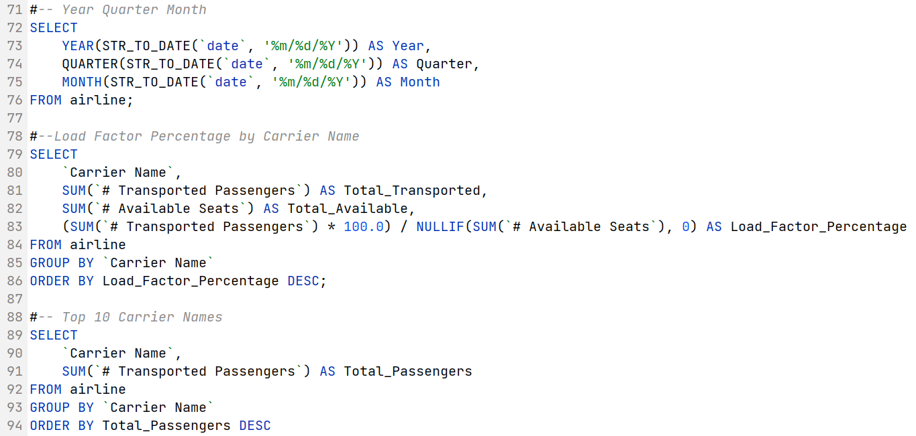
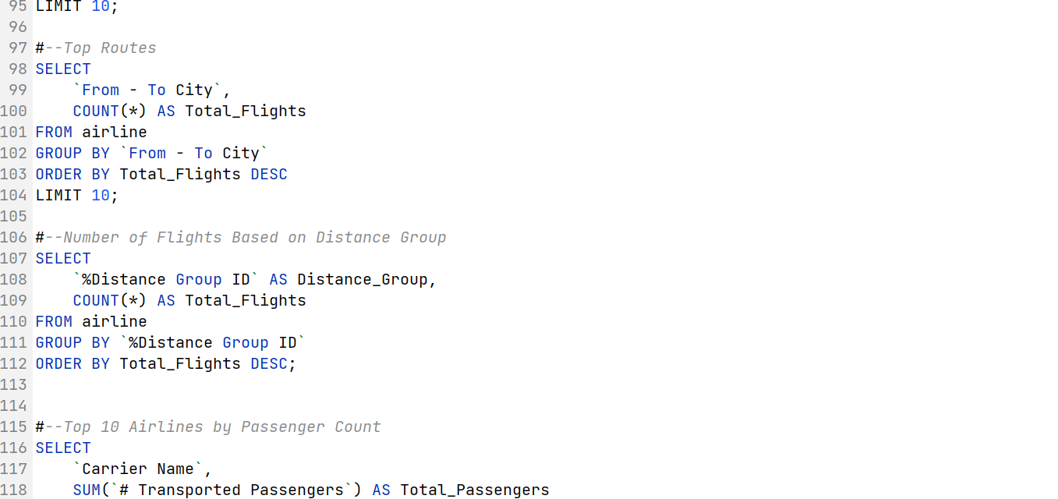
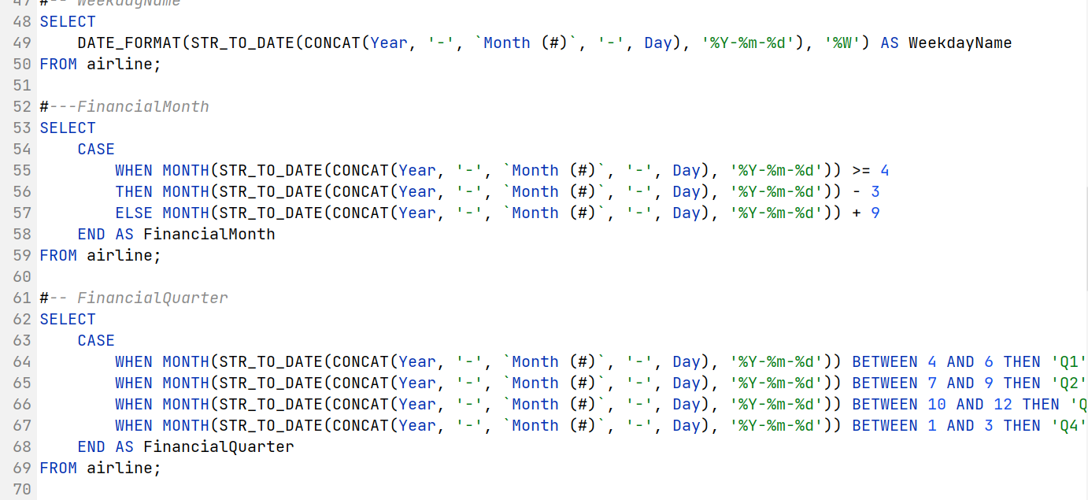
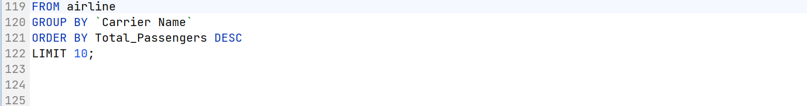
SQL Queries and Results

Slide 12
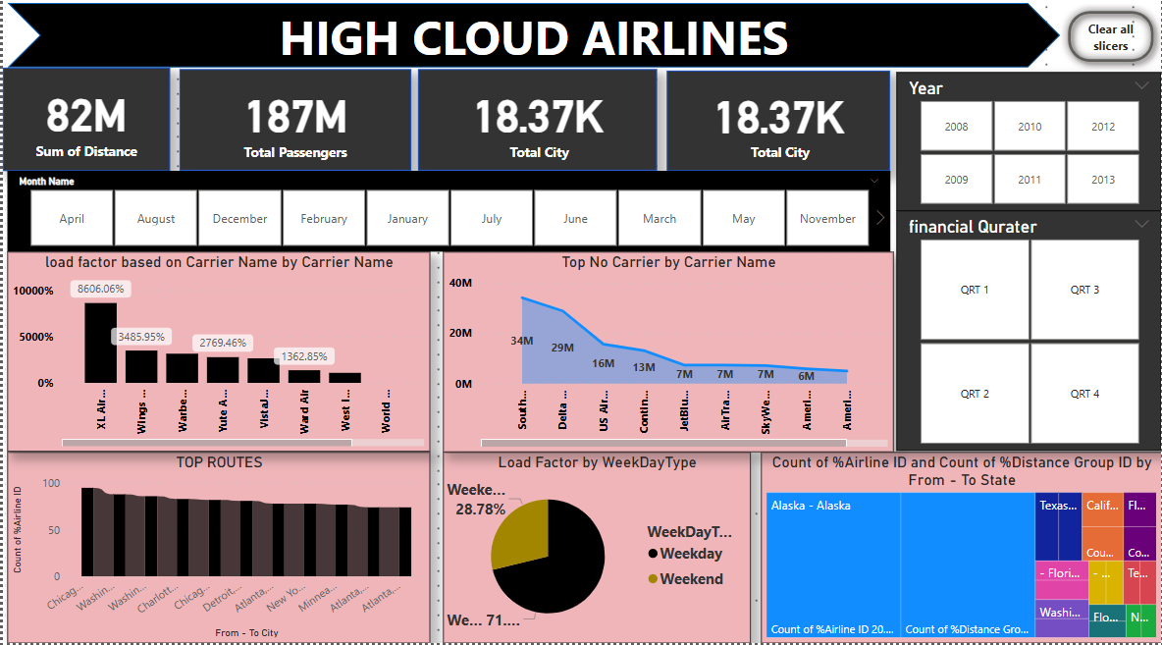
Power BI Dashboard

Slide 13
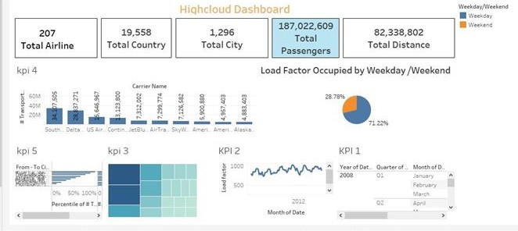
Tableau Dashboard

Slide 14
This method allows for greater flexibility ,scalability and efficiency in handling large volumes of data , making it ideal for the project.
Challenges Faced

Slide 15
High Cloud Airlines remains committed to redefining the air travel experience by maintaining high standards of customer satisfaction, operational excellence, and sustainability. With its strategic vision and focus on innovation, the airline is poised for a bright future in the competitive aviation industry.
Conclusion

Slide 16

Thank you

